Slide 1


Credit Score Analysis Project
Data Cleaning, Analysis & Visualization
Date: October 26, 2023
Instructor: Adham Osama
Presented by Team 3 for DEPI
Mark Ayman
Rawan Mahmoud
Team Leader: Data Cleaning, Presentation, Power BI
Tableau, Power BI Specialist
Jana Ehab
Filopater Hosny
Power BI, Excel Data Management
Power BI Implementation

Slide 2

Introduction
We are Team 3, a collaborative group of data analysts specializing in financial data analysis and visualization. This project focuses on analyzing credit score data to identify patterns and trends in customer financial behavior.
Understanding credit score factors is crucial for:
Informed Lending Decisions
Empowering financial institutions to make data-driven lending decisions, reducing risk and optimizing portfolios.
Improved Financial Health
Assisting customers in understanding and improving their credit scores, leading to better financial well-being.

Slide 3
Project Objectives
Clean and transform raw financial data using Power Query
Analyze credit score trends and key financial metrics
Build interactive dashboards using Power BI and Tableau
Identify patterns in customer financial behavior
Provide actionable insights for credit risk assessment

Slide 4

Dataset Overview
Our project utilizes four primary datasets, each providing crucial information for a comprehensive credit score analysis. These datasets are interconnected, forming a holistic view of customer financial behavior.
Fact_Monthly_Records_Uncleaned.csv
Dim_Account_Uncleaned.csv
148,749 rows; central transactional fact table
12,509 rows; account-level details
Dataset Relationships
Dim_Time_Uncleaned.csv
Dim_Customer_Uncleaned.csv
12 rows; time reference table
12,509 rows; customer demographics
However, working with this data presented several key challenges:
Missing values
Mixed data types
Placeholder characters
Dirty data requiring extensive cleaning

Slide 5
Before Cleaning

Slide 6
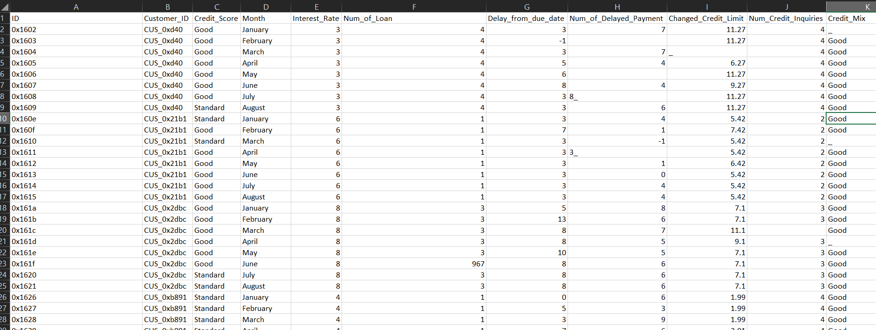
Fact Monthly Records Uncleaned

Slide 7
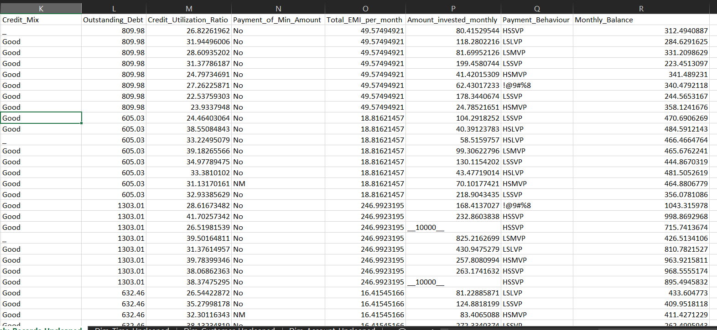
Fact_Monthly_Records_Uncleaned

Slide 8
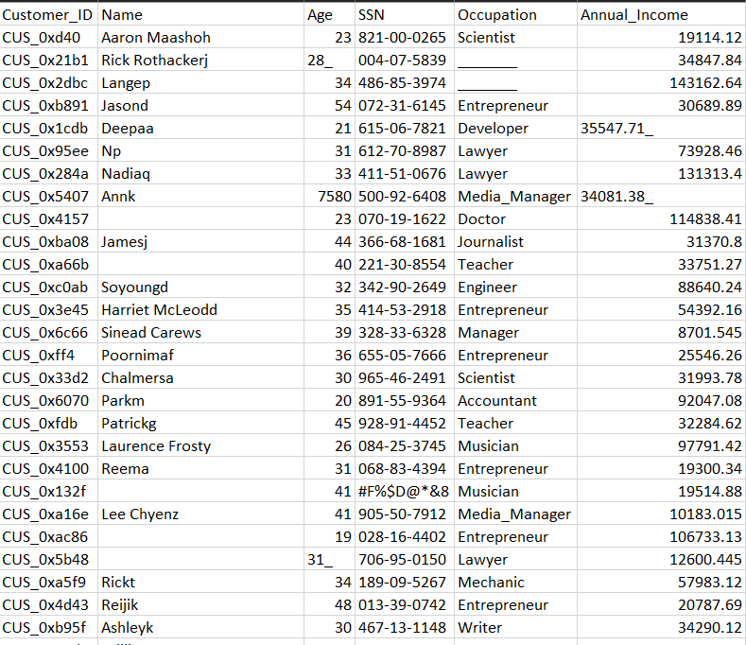
Dim Customer Uncleaned

Slide 9
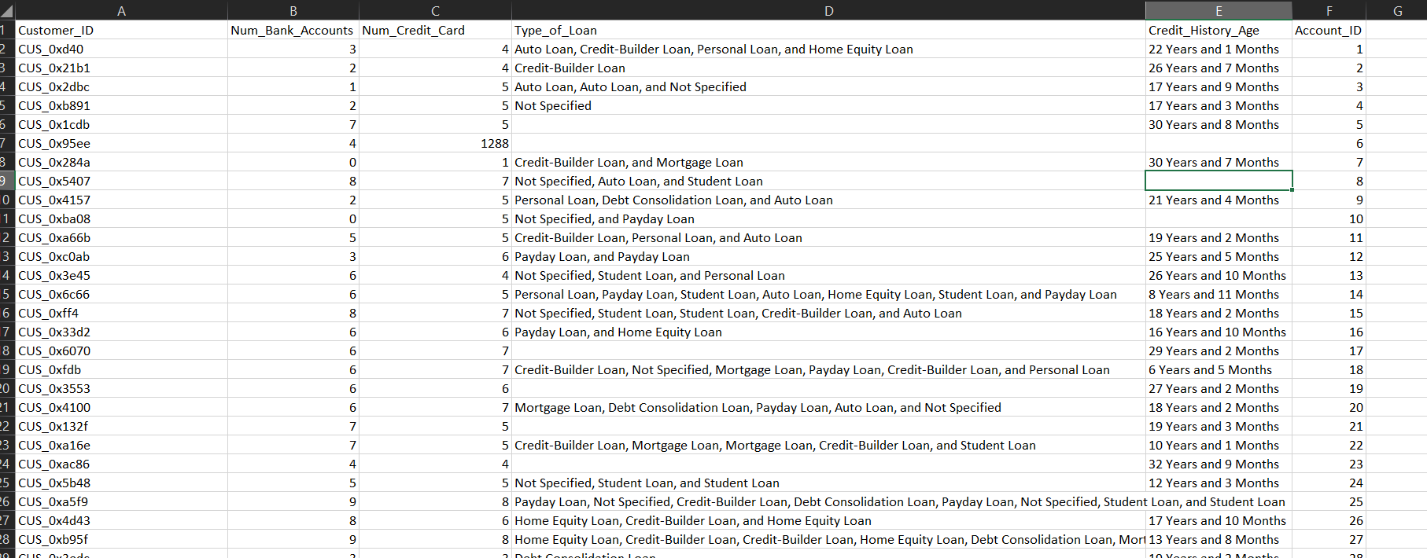
Dim Account Uncleaned

Slide 10
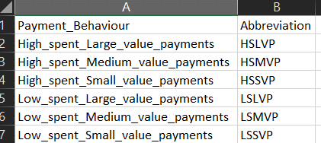
Payment Behaviour Abbreviation

Slide 11
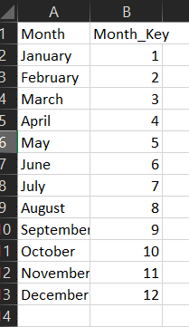
Dim Time Uncleaned

Slide 12

Data Cleaning & Preparation (Power Query)
Our initial dataset presented several challenges that required extensive data cleaning and preparation. Using Power Query, we performed the following key tasks:
Removed placeholder characters (underscores, special symbols)
Fixed data type inconsistencies (Age column mixed formats)
Handled missing values in loan types and occupation fields
Standardized credit history age format
Cleaned numeric columns that were stored as text
Merged and transformed data across multiple tables
The benefits of using Power Query for this process are clear: it provides an automated, repeatable, and highly efficient data transformation process.
Raw, inconsistent data
Clean, structured data
Ready for analysis
Missing, messy values
Power Query engine
Power Query Transformation
Normalization
Transformations and steps
Standardize formats and cases
Cleaning
Type conversion
Remove placeholders and noise
Correct data types

Slide 13
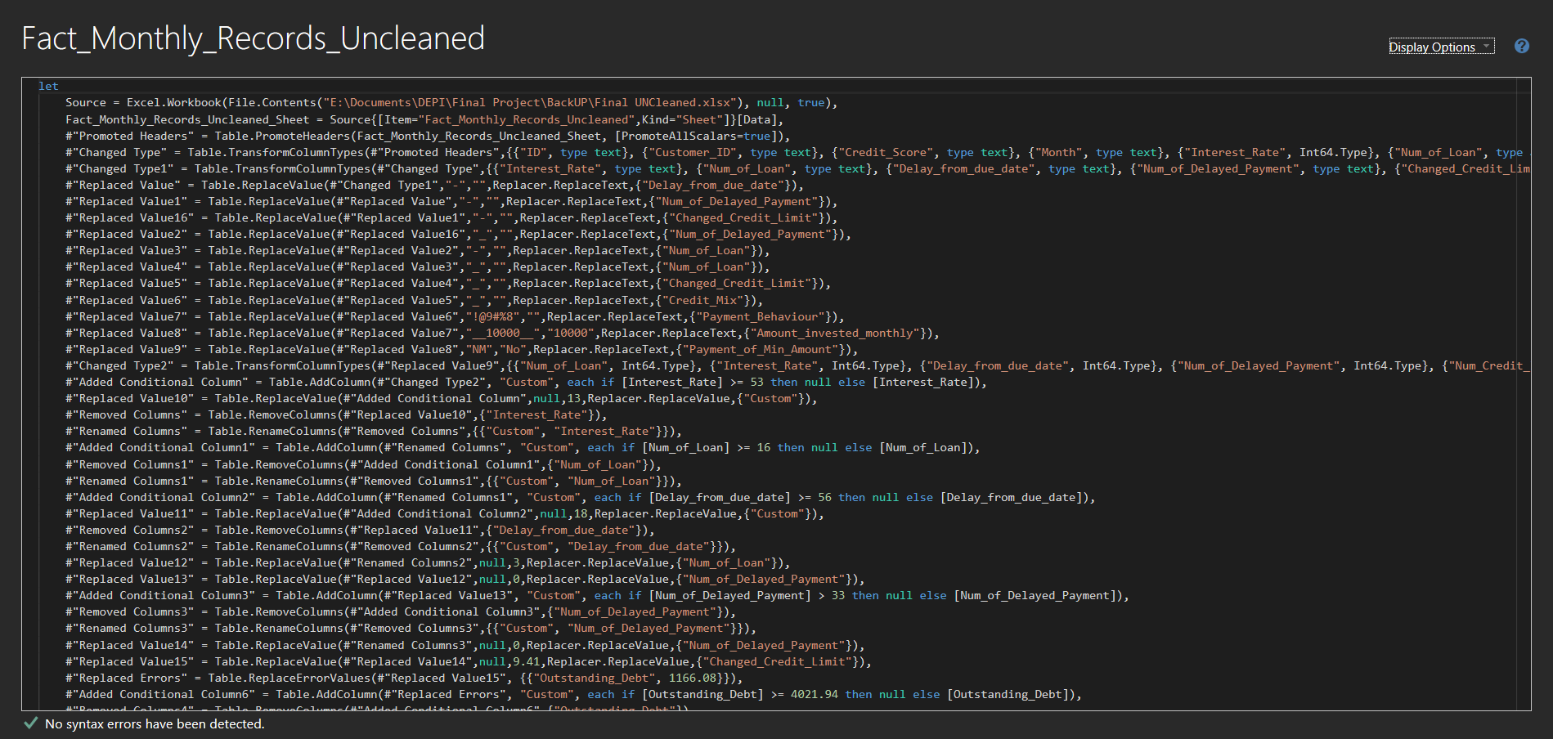

Slide 14
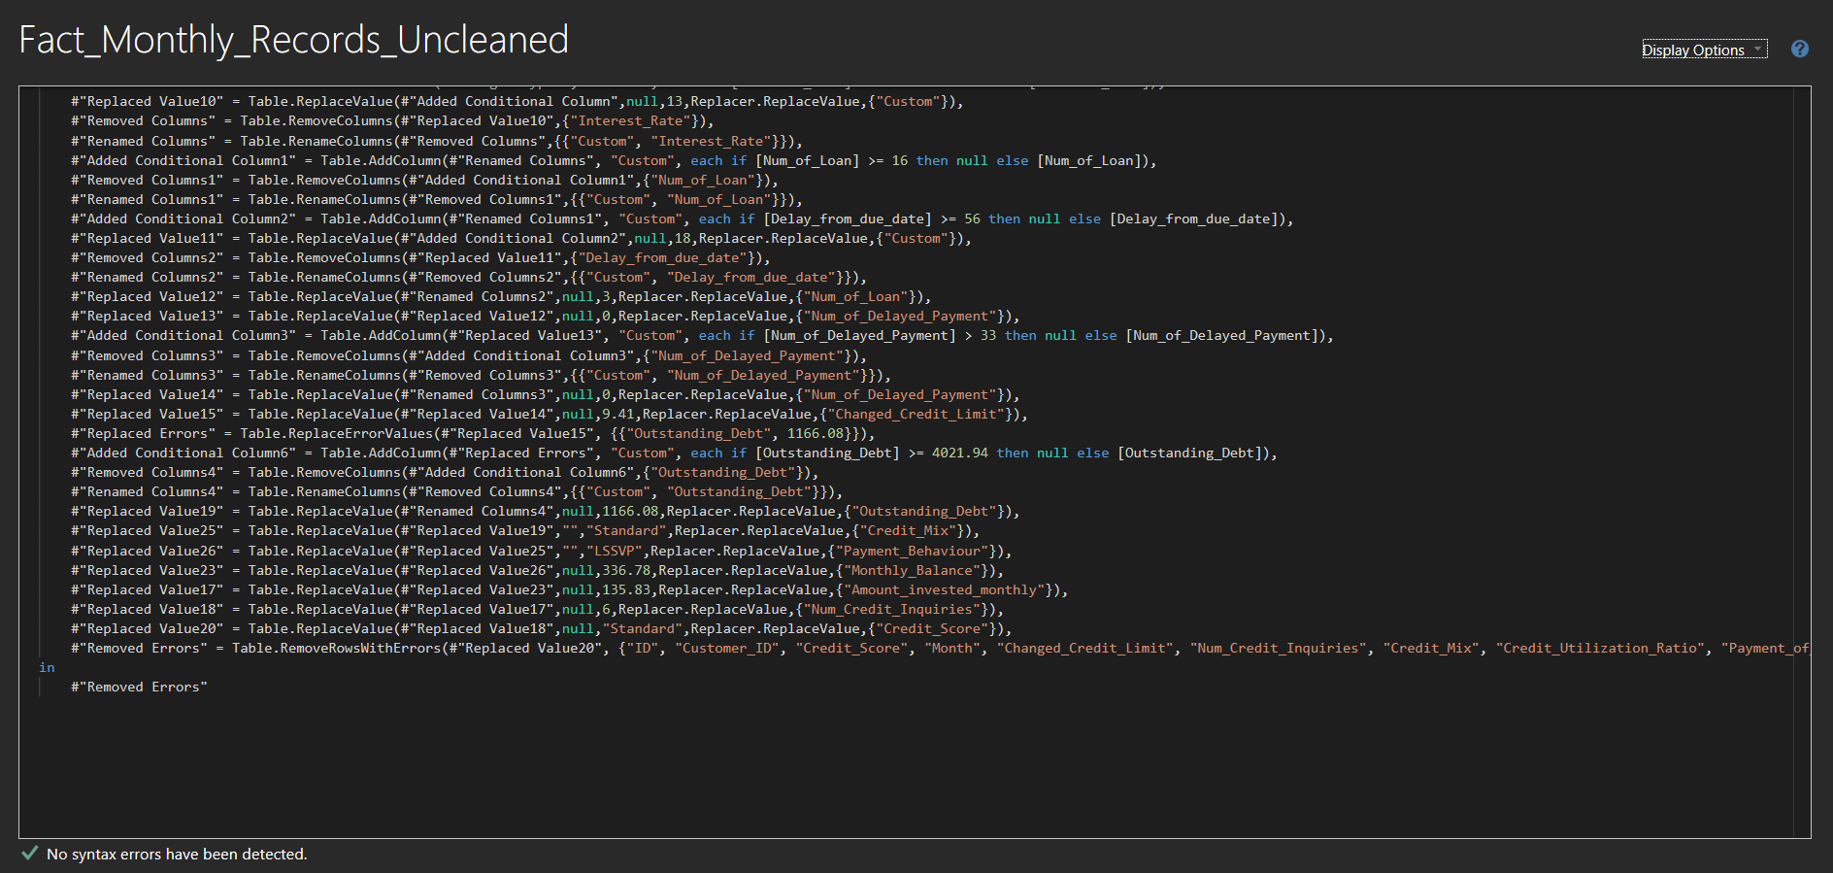

Slide 15
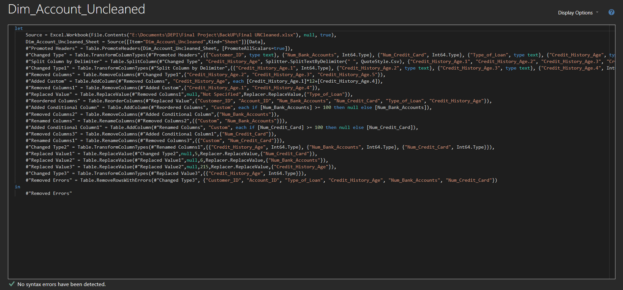

Slide 16
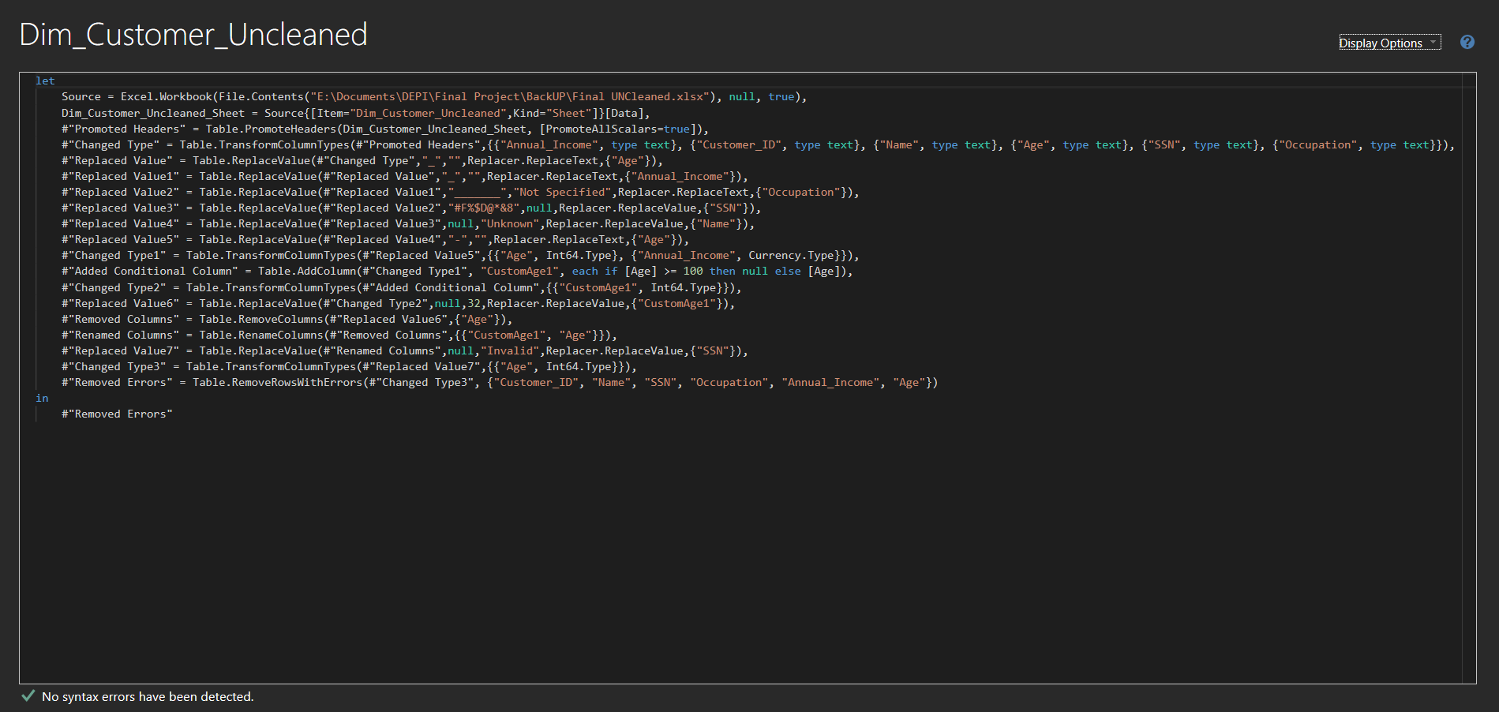

Slide 17
After Cleaning

Slide 18
DimAccount

Slide 19
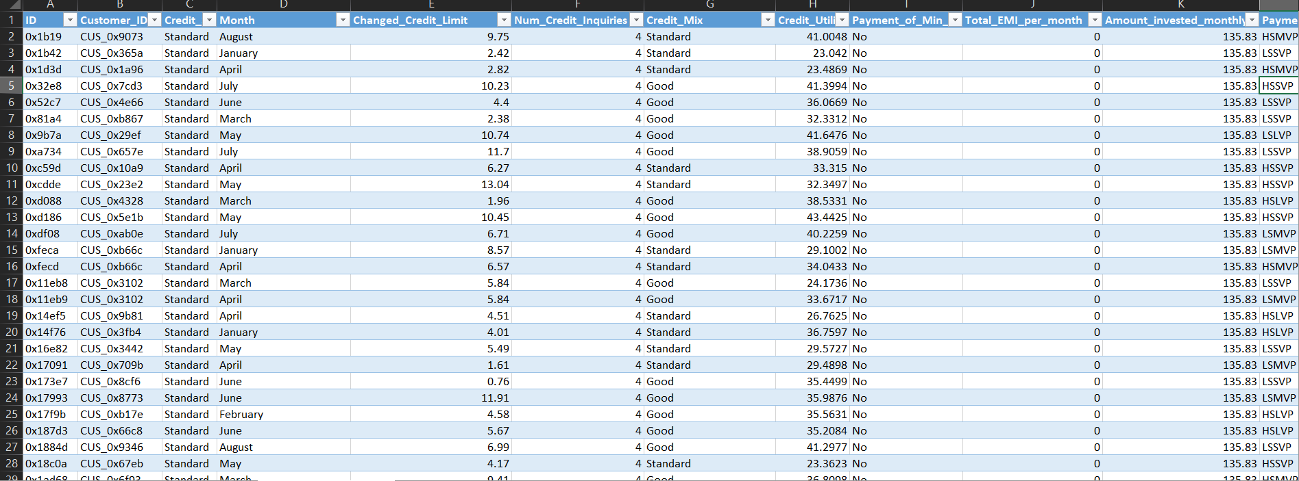
Fact Monthly Records

Slide 20
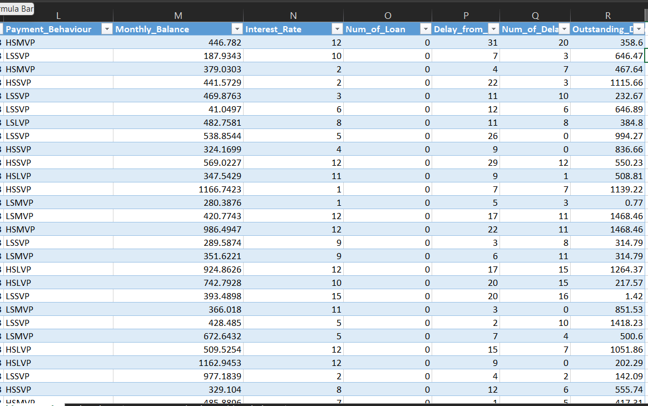
Fact Monthly Records Cont…

Slide 21
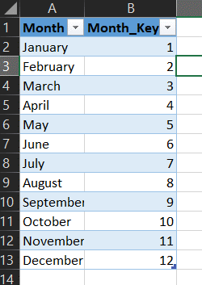
Dim Time

Slide 22
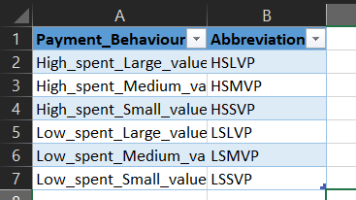
Payment Behaviour Abbreviation

Slide 23
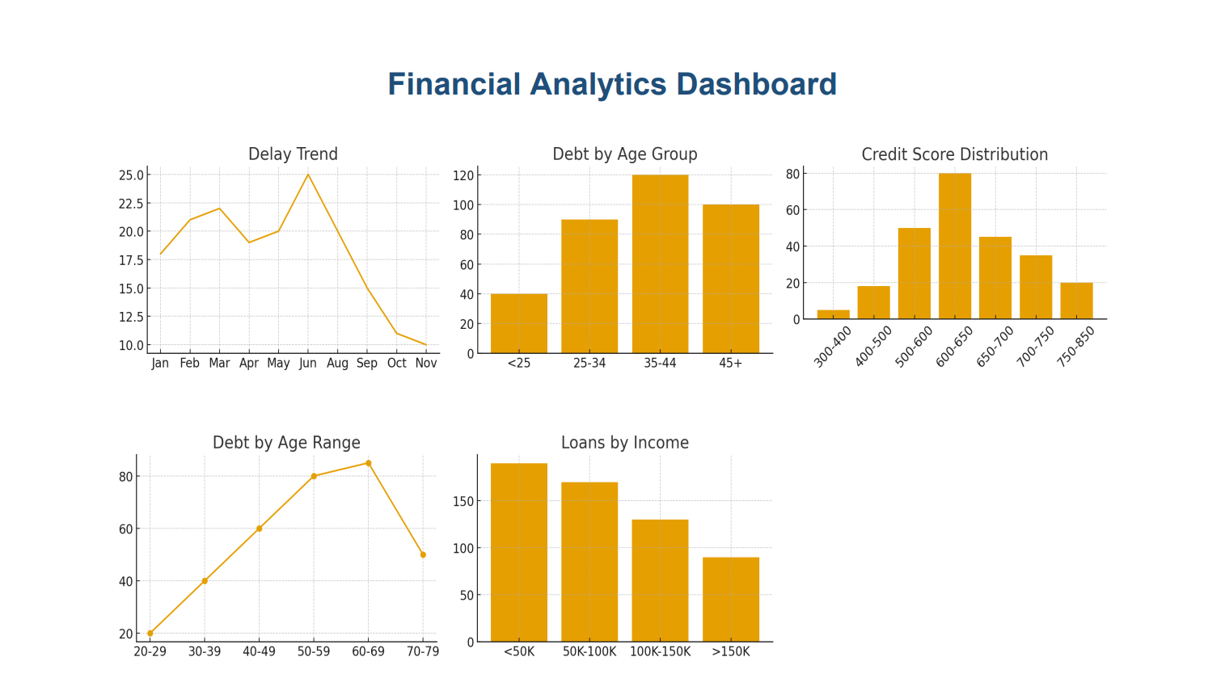
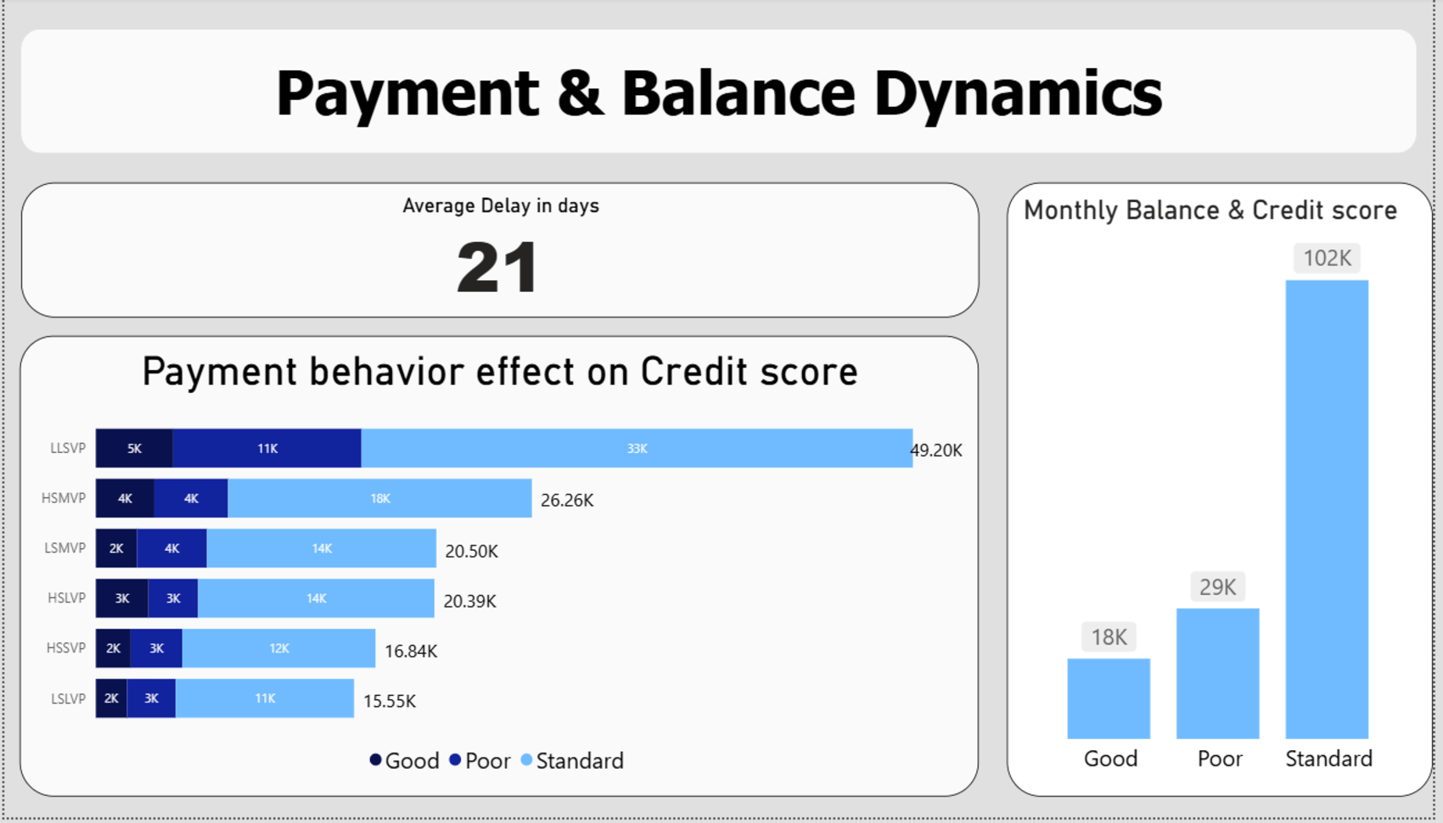
Final Dashboards
Power BI Dashboard
Tableau Dashboard
Interactive credit score analysis
Advanced storytelling visualization
KPIs: average credit score, payment behavior trends, income distribution, risk segmentation
Focus on credit score journey and comparative analysis across customer segments
Dynamic filtering by demographics and time periods
Predictive insights for risk assessment
Key Features
Real-time filtering
Drill-down capabilities
Benefits
Enables stakeholders to make data-driven decisions quickly and efficiently.

Slide 24
Excel

Slide 25
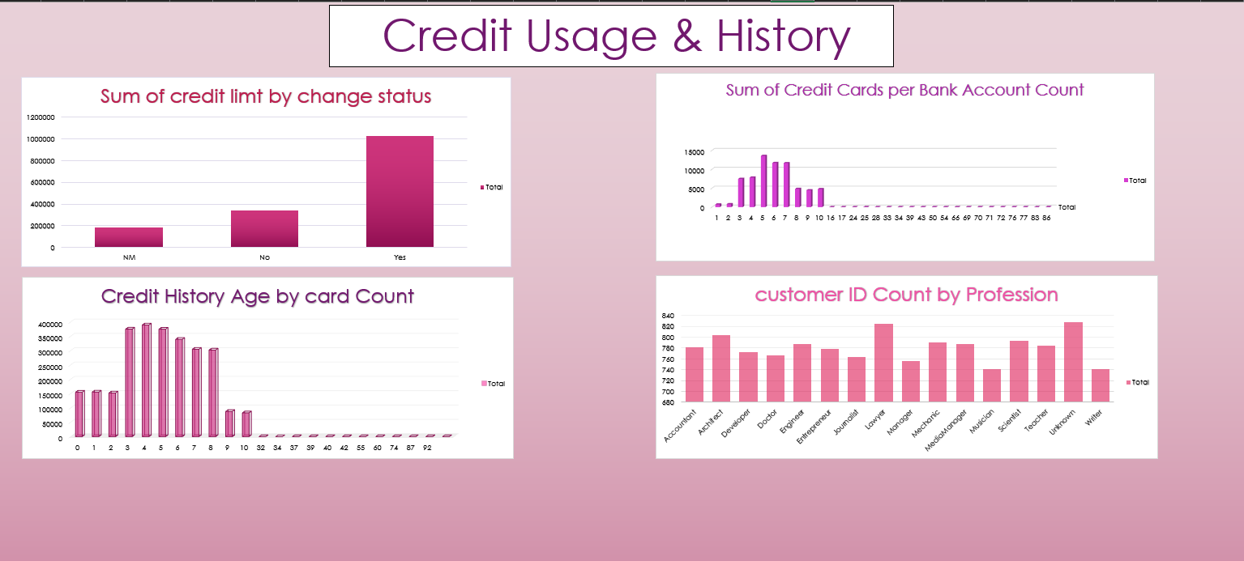

Slide 26
Tableau

Slide 27
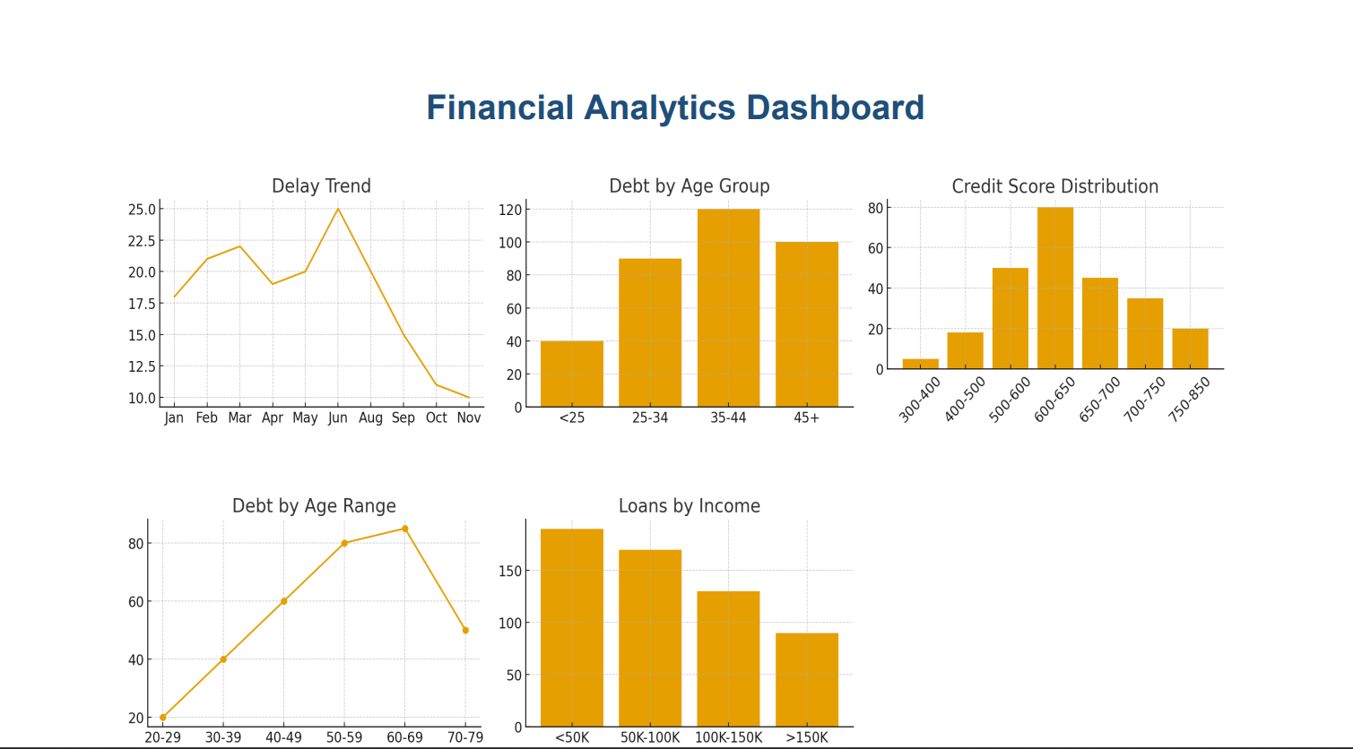

Slide 28
Power BI

Slide 29
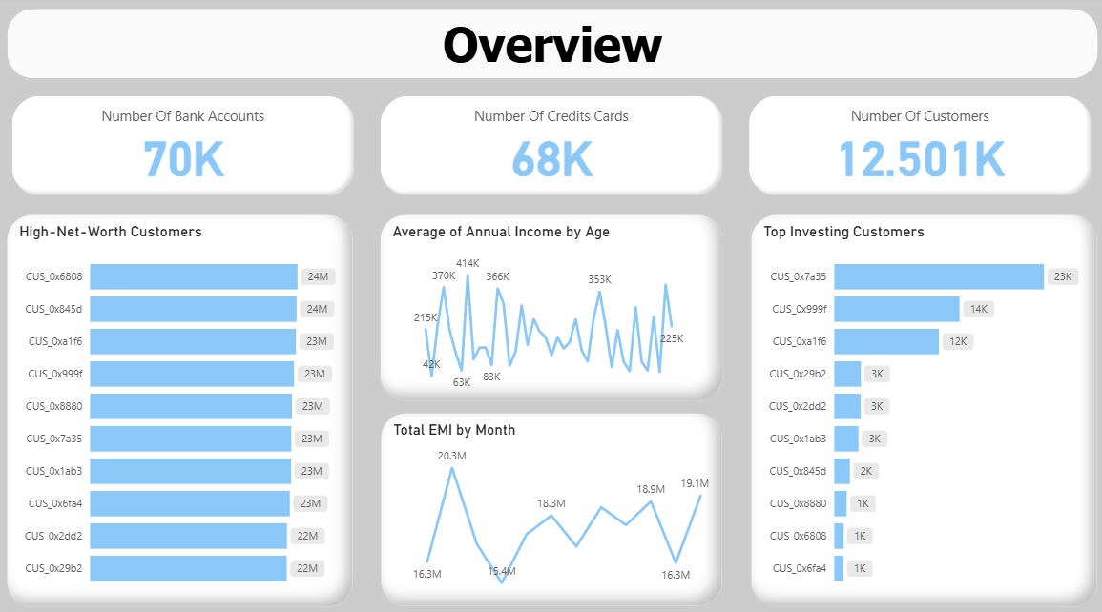

Slide 30
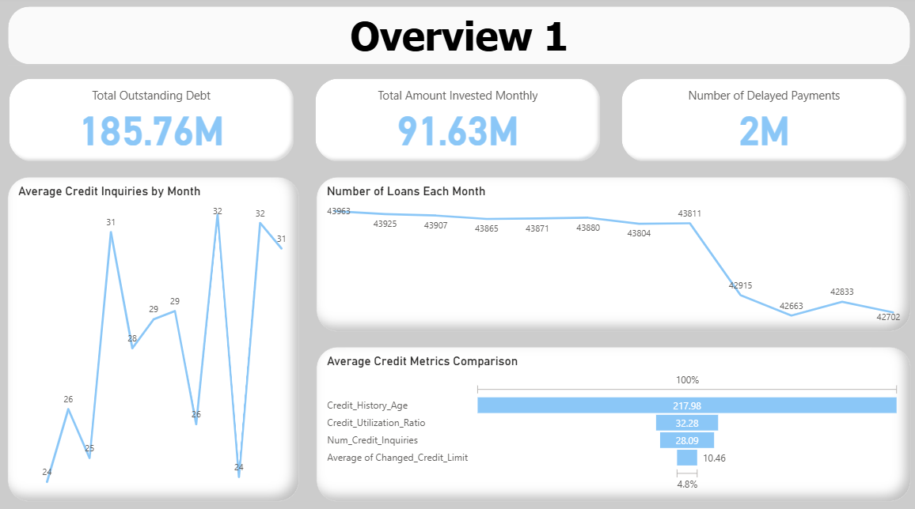

Slide 31
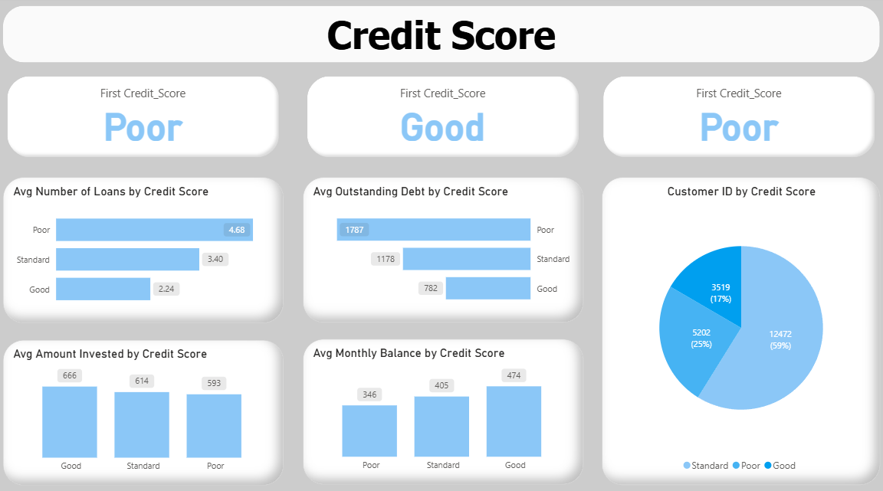

Slide 32
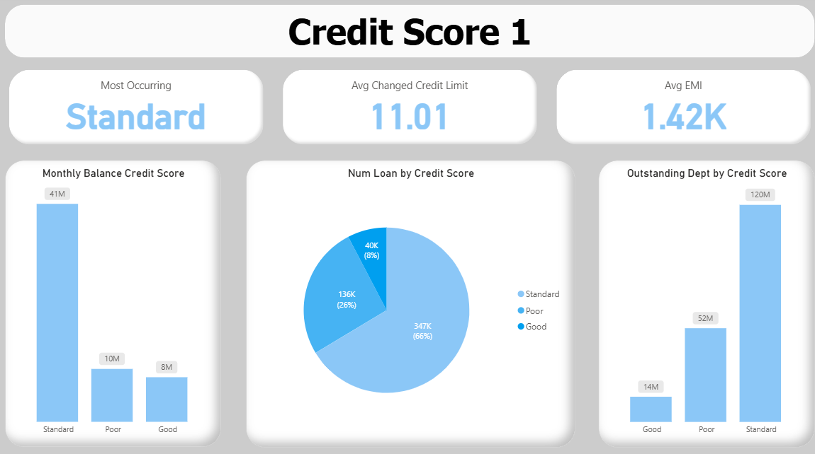

Slide 33
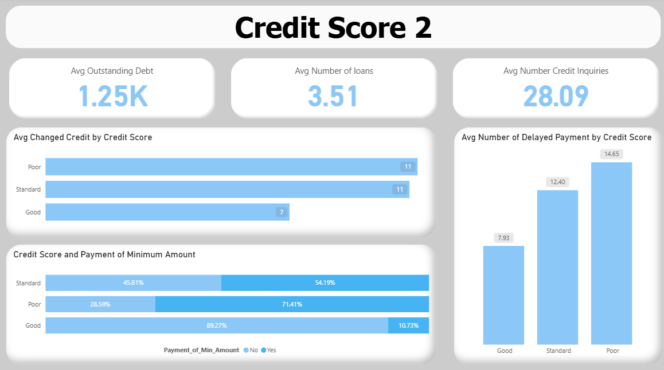

Slide 34
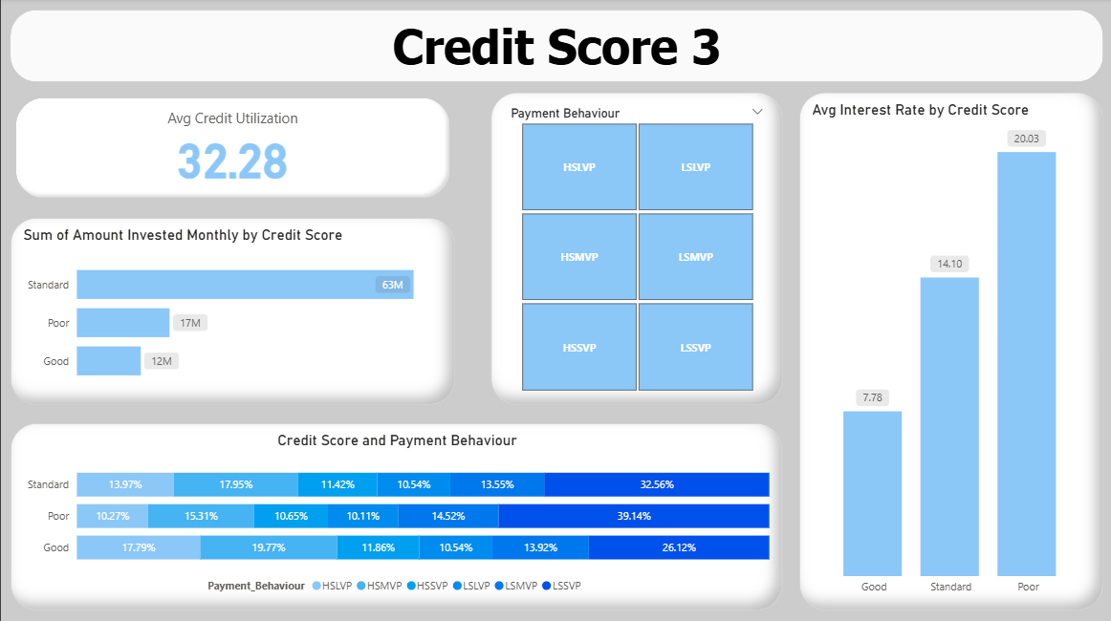

Slide 35
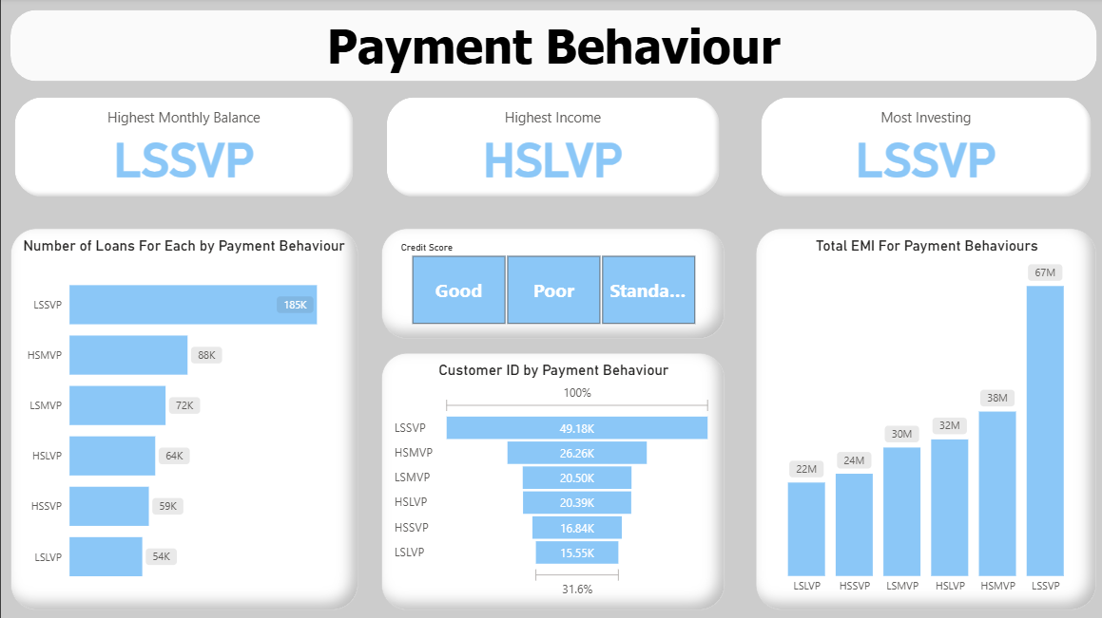

Slide 36
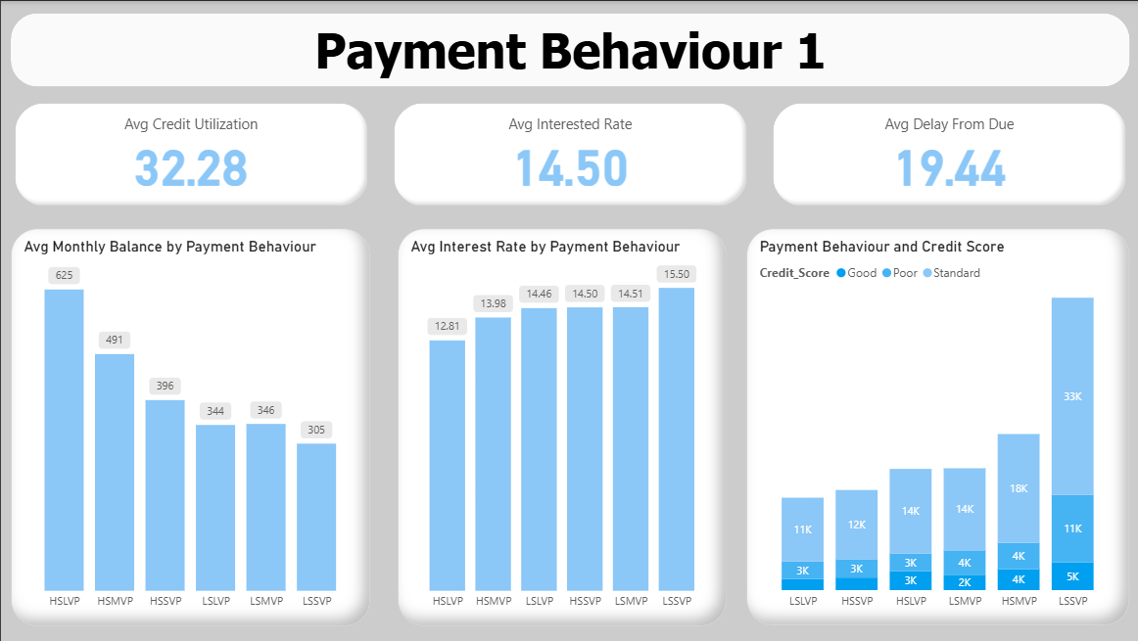

Slide 37
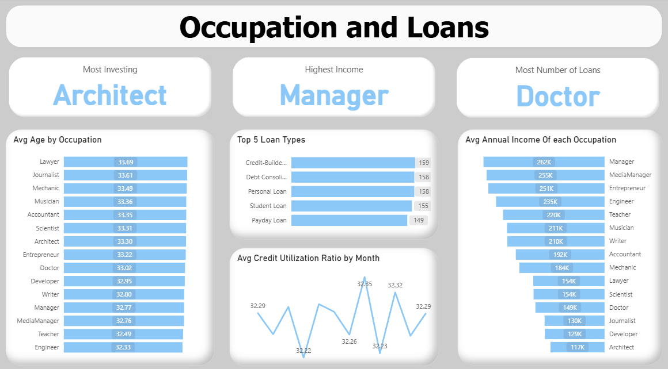

Slide 38
Tools & Technologies Used
Excel
Power Query
Initial data exploration and statistical analysis
Data cleaning, transformation, and preparation
Power BI
Tableau
Interactive dashboards and business intelligence
Advanced data visualization and storytelling

Slide 39
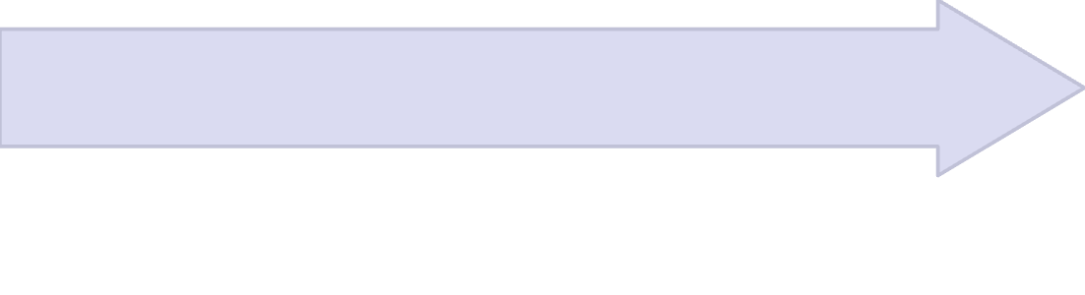
Analysis Process
Tableau Phase
Power BI Phase
Advanced chart creation
Excel Phase
Built comprehensive data model
Storytelling dashboards
Initial data exploration
Enhanced visual analytics
Pivot tables for quick insights
Created DAX measures for key metrics
Statistical checks and data validation
Developed interactive slicers and filters
Designed core visualizations
Each phase builds upon the previous one, emphasizing the progressive nature of the analysis from basic exploration to advanced visualization.

Slide 40
Key Insights & Findings
Credit Score Distribution
Income vs Credit Score
Most customers fall into "Good" credit category, with clear patterns in score ranges. This highlights an opportunity to identify target segments for credit improvement programs.
There is a strong positive correlation between annual income and credit score ratings. Financial institutions can leverage income data for more precise lending decisions.
Payment Behavior Impact
Debt-to-Income Ratio
Customers with delayed payments show significantly lower credit scores. Implementing early warning systems for payment delinquency can help mitigate risk.
Higher outstanding debt relative to income correlates with poor credit scores. This suggests offering debt consolidation or financial counseling to at-risk customers.
Credit History Length
Account Diversity
Longer credit history generally leads to better credit scores. It is crucial to educate new borrowers on the importance of establishing and maintaining credit responsibly.
Customers with multiple account types tend to have more stable credit scores. Encouraging responsible diversification of credit products can lead to better financial health.

Slide 41
Recommendations
Implement Early Warning Systems
Monitor payment behavior patterns to identify at-risk customers before defaults occur. This proactively mitigates risk and improves loan portfolio health.
Develop Income-Based Lending Models
Use income correlation insights to create more accurate risk assessment frameworks, leading to better lending decisions and reduced default rates.
Offer Financial Education Programs
Target customers with shorter credit histories to improve long-term creditworthiness, fostering responsible financial habits and customer loyalty.
Create Debt Management Services
Provide counseling and consolidation options for high debt-to-income ratio customers, helping them manage debt and maintain credit stability.
Diversify Product Offerings
Encourage responsible use of multiple credit products to improve customer stability, which can lead to stronger financial relationships and cross-selling opportunities.
Implement Dynamic Risk Pricing
Adjust interest rates based on real-time credit behavior analytics, ensuring fair pricing and effective risk management.

Slide 42
The Credit Scoring Challenge
Current analysis reveals that traditional credit assessment methods miss critical behavioral patterns, creating both unnecessary risk and missed opportunities for financial institutions.
The Reality
The Challenge
The Impact
Most customers fall into mixed credit tiers, but income alone doesn't predict creditworthiness effectively.
How do we identify high-quality borrowers hidden within standard credit segments while minimizing default risk?
Better credit scoring enables smarter lending decisions, reduces portfolio risk, and unlocks new revenue opportunities.

Slide 43
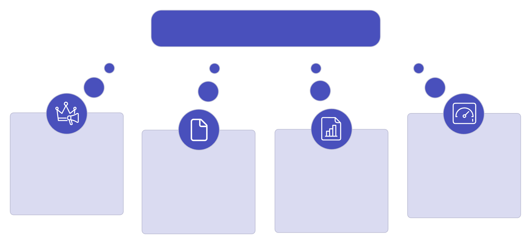
Team Roles & Contributions
Successful Project Outcome
Mark Ayman
Team leader; data cleaning, Visualization, Insights
Rawan Mahmoud
Filopater Hosny
Jana Ehab
Tableau ,PowerBI visualizations expert
Analysis ,Excel ,PowerBI
PowerBI
Collaboration Benefits
Combined expertise in different tools created comprehensive analysis
Diverse perspectives improved problem-solving
Shared workload enabled thorough exploration of the dataset

Slide 44
Challenges & Limitations
Key Challenges Faced
How Challenges Were Overcome
Data Quality Issues
Systematic Data Cleaning
Extensive missing values, inconsistent formats, and placeholder characters required significant cleaning effort.
Systematic data cleaning approach using Power Query automation.
Team Collaboration
Large Dataset Complexity
Team collaboration to divide complex tasks efficiently.
Managing 148,749 records across multiple tables demanded careful memory and performance optimization.
Iterative Development Process
Tool Integration
Iterative development process to refine visualizations.
Coordinating analysis across Excel, Power Query, Power BI, and Tableau required workflow synchronization.
Regular Progress Reviews
Regular progress reviews to stay on track.
Time Constraints
Balancing thorough analysis with project deadlines while ensuring quality deliverables.

Slide 45

Conclusion
Project Achievements
Why the Results Matter
Successfully cleaned and analyzed 148,749+ financial records
Enables better risk assessment and lending decisions
Helps customers understand credit improvement pathways
Identified key factors influencing credit scores
Created comprehensive interactive dashboards
Supports financial inclusion through data-driven insights
Provided actionable insights for financial institutions
Data-driven credit analysis empowers both financial institutions and customers to make informed decisions, ultimately promoting financial health and stability.

Slide 46

Questions & Discussion
Thank you for your attention! We welcome your questions and feedback.
For follow-up, please reach out to our team:
Mark Ayman, Rawan Mahmoud, Jana Ehab, Filopater Hosny
We are available for further discussion.

